Slide 1
Safety at SM FIRST Lab

Slide 2
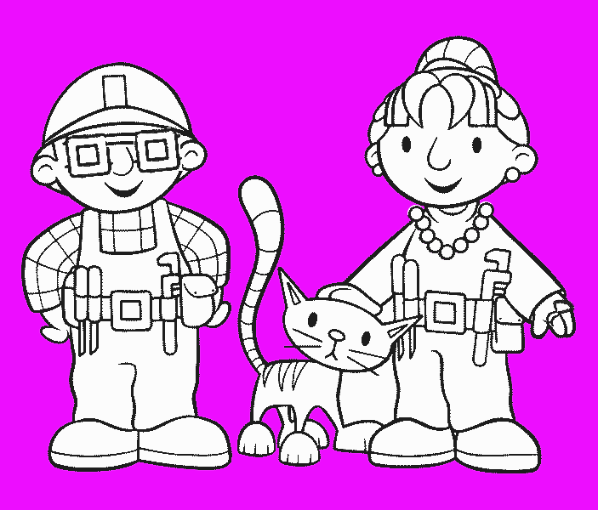
Personal Safety Rules
1. Tie Long Hair Back
1. Tie Long Hair Back
1. Tie Long Hair Back
2. Wear Head Gear If Necessary
2. Wear Head Gear If Necessary
2. Wear Head Gear If Necessary
2. Wear Head Gear If Necessary
2. Wear Head Gear If Necessary
3. Be Smart
3. Be Smart
3. Be Smart
4. Wear Safety Glasses
4. Wear Safety Glasses
4. Wear Safety Glasses
5. Wear Ear Protection If Necessary
5. Wear Ear Protection If Necessary
5. Wear Ear Protection If Necessary
6. Remove Jewelery
6. Remove Jewelery
6. Remove Jewelery
7. Wash Hands
7. Wash Hands
7. Wash Hands
8. No open toe shoes
8. No open toe shoes
8. No open toe shoes

Slide 3
Attitude
Tools greatly reduce the time needed to perform an operation and usually improve your ability to do a job.
Learn how to use tools properly and take pride in your ability to use a tool safely and effectively.
Be careful to think through each operation before you do it. Use your common sense. Do not do things that seem unsafe.
People using the shop must take responsibility for the safe use of the facility. If you are unsure of the proper method to do something, ask for help.
Never perform an operation that you are uneasy about. Ask for help!
SPINDLE
CHUCK
TABLE

Slide 4
Attitude
If you notice an unsafe condition in the shop, fix it or bring it to the attention of the instructor.
If you think someone is using the equipment unsafely, suggest a safer alternative or bring their activities to the attention of the instructor.
ARBOR
SPINDLE

Slide 5
List General Shop Safety Rules
Keep all hand tools
Sharp
Clean
In safe working order
(If a tool is broken, notify your instructor to have the tool sharpened or repaired)
Never operate a hazardous machine unless
You have been instructed on how to use it
You have properly demonstrated the correct way to use it safely

Slide 6
List General Shop Safety Rules
With the power off, make sure that parts can move freely before turning equipment on.
Make sure equipment has stopped completely before leaving.
Keep the shop
*clear of scraps and litter
*free of spilled liquids
Before repairing or making any adjustments to a machine,
*Disconnect the power
*Make sure the equipment has stopped moving

Slide 7
Clean and Orderly Shop
Arrange machinery and equipment to permit safe, efficient work practices.
Put tools, materials and supplies away in their proper place when finished with your projects.
Clear working areas and benches of debris and other hazards.

Slide 8
Safety Equipment
Do not distract machine operators.
Make sure that all guards are in place and that they work properly.
Keep hands at least four inches away from cutting surfaces.

Slide 9
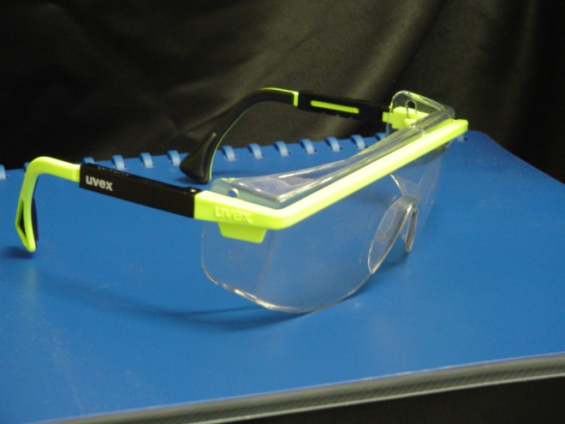
Protect the Most Important Tools You Have
Your Eyes are not tools, but they are our most important sense, and it is very difficult to get by without them.
Always use approved eye protection whenever cutting, hammering, using a power tool, in the vicinity or watching someone else doing these things!
Make it a Lifelong Habit to recognize hazards to your eyes and take precautions to protect your eyes, not just when someone is standing over you and making you do it.

Slide 10
Getting Ready to Work
Before presenting yourself and your project to the instructor for permission to use a power tool, make sure you are READY!
Have your safety glasses in place, hair, clothing and jewelry secured.
Make sure your project is ready also. Have you made all the necessary layout marks in preparation for cutting? The instructor will not assume you know
what you are doing – you must PROVE
it by your presentation.

Slide 11
Cleanup
Report all injuries to the instructor immediately.
Report missing, broken or damaged tools to the instructor.
Keep the shop clean and well organized.

