Slide 1
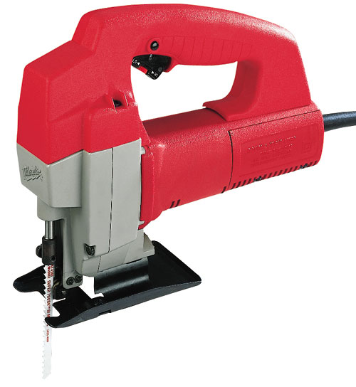
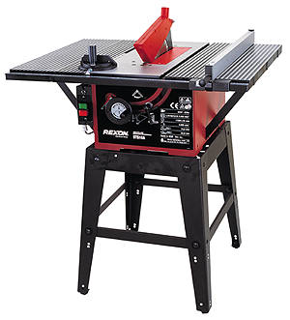



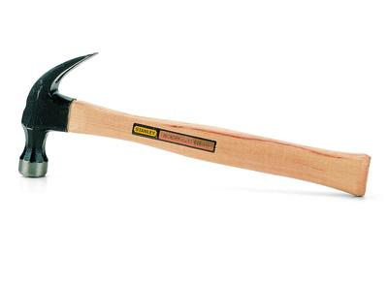




Hand & Power Tool Safety

Slide 2

Hazards Associated with
Hand & Portable Power Tools
Electric shock
Amputation
Eye injuries
Hearing loss
Puncture wounds
Cuts and abrasions
Contusions/crushing
Burns

Slide 3
Common Causes of Injuries
Electric Shock
*Improper grounding (removing the ground prong from the plug)
*Not unplugging equipment when changing accessories
Frayed cords
*Pulling on the cord to unplug the equipment
*Standing in water or wet surfaces
*Not using a ground fault circuit interrupter (GFCI)

Slide 4
Common Causes of Injuries
Amputation, puncture wounds, cuts, abrasions, contusions and burns
Removal of guards
Using damaged equipment
Improper use of equipment
Using the wrong tool

Slide 5
Common Causes of Injuries
Hearing loss and Eye injuries
Not wearing the correct personal protective equipment (PPE) such as ear plugs or muffs
for the ears and safety glasses, goggles or
face shields for the eyes

Slide 6
Five Basic Rules to Prevent Injuries
1. Keep all tools in good condition with regular maintenance
2. Use the right tool for the job
3. Examine each tool for damage before use and do not use damaged tools
4. Operate tools according to the manufacturers’ instructions
5. Properly use the appropriate PPE (i.e.,
safety glasses, leather gloves, steel toed shoes)

Slide 7



Hand Tools

Slide 8




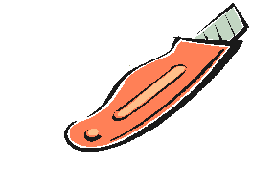
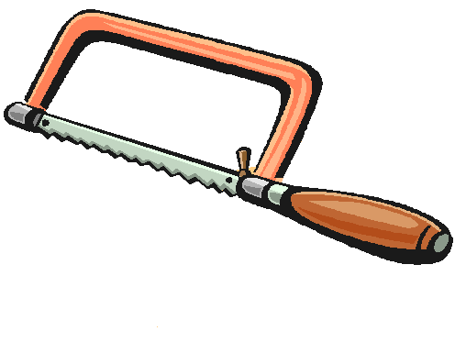


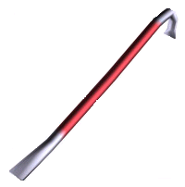




Hand Tools
Screwdrivers
Hammers
Punches
Handsaws
Chisels
Files
Hand snips
Axes
Knives
Box cutters
Wrenches
Crowbars/pry bars
Hooks
Pliers

Slide 9


Hand Power Tools

Slide 10

Categories of Hand Power Tools
There are five primary groups of hand power tools based on their power source:
Electric
Pneumatic
Gasoline
Hydraulic
Powder-actuated or butane actuated

Slide 11
Hand Power Tools
Electric:
Soldering irons
Circular saws
Drills
Grinders
Reciprocating saws
Sanders
Routers
Pneumatic impact tools or air-powered tools:
Grinders
Nail guns
Wrenches
Hammers

Slide 12
Tool Selection
Select the right tool for the job
Consider the tools shape and size – the tool should be comfortable to hold
Do not select undersized tools for the job
Consider the quality of the tool including its sharpness for cutting

Slide 13
Carrying or Transporting Tools
Use a tool box, tool-holder, belt or pouch,
this will protect the person and the tool
Carry pointed or sharp tools with the point
or cutting edge away from the body
Do not carry tools by hand up ladders
Do not lay tools down where people can
trip on them or they can fall on someone
Hand tools off, do not throw them

Slide 14
Using Hand Tools
Select and use the appropriate PPE (i.e.,
safety glasses, leather gloves, steel toed shoes)
Read and follow the manufacturer’s instructions
Create a safe work area by keeping people at a safe
distance and removing objects that may get in the way
Use the tool as it is attended to be used (i.e.,
don’t use a screwdriver as a punch, pry or wedge)

Slide 15
Using Hand Power Tools
Disconnect electric cords when working on or
around electric appliances
Use the correct size tool for the job (i.e. match the screwdriver with the screw head)
Pull wrenches and levers towards yourself-this
will provide better control

Slide 16
Using Hand Power Tools
Select and use the appropriate PPE (i.e.,
safety glasses and ear plugs, steel toed shoes)
Read and follow the manufacturer’s instructions
Create a safe work area by keeping people at a safe distance and removing objects that may get in the way
Use the tool as it is attended to be used

Slide 17

Using Hand Power Tools
Make sure the power cord is not in the path of
blades or other cutting implements
Avoid placing cords or hoses where they
will be a tripping hazard
Never unplug a power tool with the switch
in the on position
Use a ground fault circuit interrupters
when working in wet areas

Slide 18
Using Hand Power Tools
Make sure guards are in place
Do not over extend the arm-this can cause a
loss of balance or control of the power tool
Do not wear loose fitting cloths that can get
caught in the power tool
Unplug the power cord when changing
accessories

Slide 19

Using Hand Power Tools
Never remove saws while blades are in motion
Do not place hands or fingers into the cutting area until
the blade has stopped
Never carry a hand powered tool by the power cord

