Slide 1
Basic Carpentry Hand Tools: Hammers
By Ryan Saucier

Slide 2
Hammers
Various types
Used to drive nails, pull nails and adjust boards or move objects.
Never strike one hammer head against another. The force could break both hammers and cause an eye injury.

Slide 3
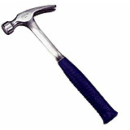
Straight Claw Hammer
When nails are too close to a wall or ceiling, the claw hammer handle may hinder your nail pulling efforts. The straight claw hammer would be more effective in these situations, while having other practical uses as well (Ex: as a chisel).

Slide 4
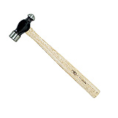
Ball-Peen Hammer
Much like the welder’s hammer, this tool is designed to work on metals, but unlike the welder’s hammer, its rounded head is used primarily to shape metal surfaces. It is also a more compact tool than its soft-headed cousin, making it easier to work with in small areas or hard-to-reach places.

Slide 5
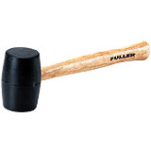
Mallet
Rubber headed hammer used in applications where you need to strike a surface without causing damage; when installing floor boards or hubcaps for instance. Typically made of black rubber, mallet heads are also available in white rubber, which helps prevent surface marks.

Slide 6
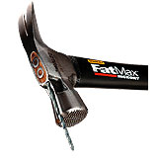
Types of Hammer Heads
Finally, there are a few standard hammers that come equipped with a notch where nails may be inserted, thus allowing users to “start” the nail with a hammer strike.

Slide 7
Hammer Maintenance
It is recommended that hammers be stored in a dry location and that they be wiped down if wet.
To avoid injury, never leave any tool within reach of a child.
Use added caution when using a tool in proximity to electrical installations.
Always wear safety glasses.
Grip the hammer firmly and strike using the entire arm and not only the wrist.
Never use a hammer with a damaged handle or head.
Always look behind you before starting the required swing to make your strike.

Slide 8
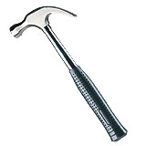
Claw Hammer
This classic hammer, with the claw shaped to maximize leverage, is ideal for removing nails. It is the standard all-purpose hammer and an indispensable object in any tool box.

